Slide 1
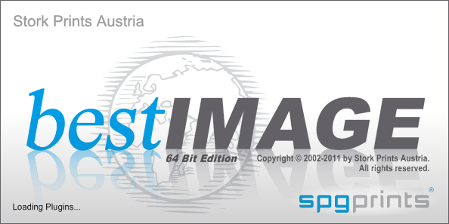
bestIMAGE 5.50
Exlore the new features of
CAD

Slide 2
NEW FeatureS
Design Manipulation and Editing
Functions
New function “Stitch" for seamless merging of distorted scans.
"Scale" function now supports bi-cubic interpolation for smooth scaling results.
"Spot filter" function now supports spot size up to 1000 pixel
Photoshop support up to CS5.1
Autoplace improvements (random mode, fit to repeat, contour placer).
Edit
New smooth drawing tools (highest quality drawing tools and modes supporting a flow factor).
New cursor dynamics and cursor shapes (Angle jitter, Scattering, Intensity jitter, Flow jitter, Apply count, Size jitter, Flip jitter, etc.) for more effective and artistic drawing.
Drawing tool "Polygon" now supports fading and tapering.
Draw with taper/fade after mouse button release.
Drawing tool "Transfer tone" with new option "Add density" to add instead replace halftones.
Display/Hide all none-drawing separations quick with keyboard shortcuts.
Clone from other files.
Clone without background regions.
Drawing mode "Fill Shade" now has options to define complex graduations.
New option "Fit to repeat" for vector object repeater. *
Vector objects now can be named. *
New drawing mode "Image restoration" to repair scratches or defect in an image.
New option to change size of several vector objects but keep individual positions.
Combine vector object group to path object. *
Split path object to sub path objects. *
*… small improvement with no detailed page present in this presentation

Slide 3
NEW FeatureS
Production/Engraving
Raster dot jitter for highlights to prevent Moiré effects.
New FM Raster "Clear dots" for smoother prints than traditional Random raster.
New "Line" Raster.
Job automation support. (job database to spool jobs direct to output machines).
Job editor works more fluent because user must not wait till object placement is ready calculated.
Colouring/Simulation
Color recipes support in color books to manage multiple recipes per color for dyestuff groups and substrates.
3 additional PANTONE color books:
PANTONE Fashion+Home cotton TCX-New Colors (175 colors)
PANTONE Fashion+Home paper TPX-New Colors (175 colors)
PANTONE Fashion+Home nylon brights TN (21 colors)
Intermediate colors can now be printed.
General
Cursor diameter displayed in mm/inch.
Change screen property (virtual, non-virtual).
Editable Mesh list for screen printing forms.
Magnifier window to pan through file with inspection marking option.
Manual input of grid lines possible.
Save As TIFF options are now stored.
Automatic database reconnection after lost connection (to improve operation on poor networks, or reconnection after PC wakeup from standby).
ICC v4 profile support + black point compensation for ICC v4 profiles.
New PDM reports user interface.
*… small improvement with no detailed page present in this presentation

Slide 4
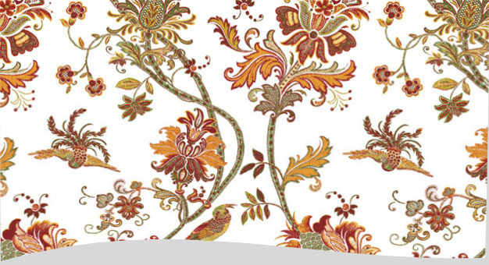
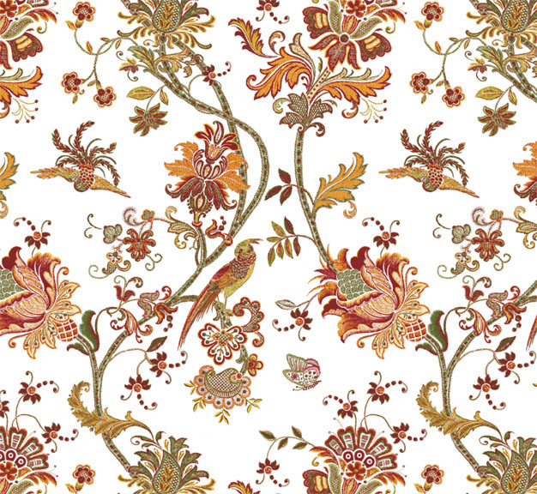
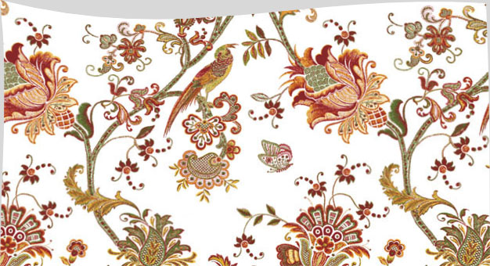
New function STITCH
Design Manipulation and Editing
Seamless stich together distorted scans by just defining some reference point pairs (pink lines) and the maximum de-skewing region (green lines).

Slide 5
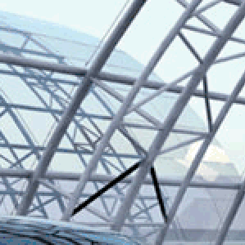

SCALE with bi-cubic interpolation
Scale now supports bi-cubic interpolation to provide smoother scaling results compared to standard anit-alias mode.

Slide 6
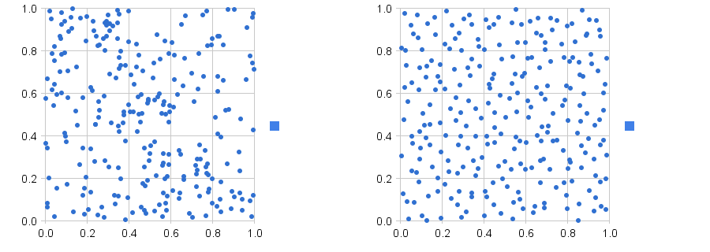
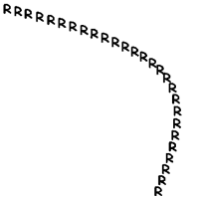
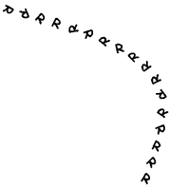
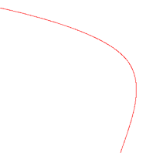
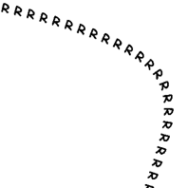
Autoplace improvements (random mode, fit to repeat, contour placer).
Random: For a better Random placement. Also overlaying placed shapes are allowed.
Geometry: Objects are adapted to one repeat.
Contour: New Mode to place shapes along a defined contour. 3 Modes are available to place the shapes along the contour (Aligned, Random, None).
With slider you can define the border shading of an halftone file as contour (like the contour filter).

Slide 7
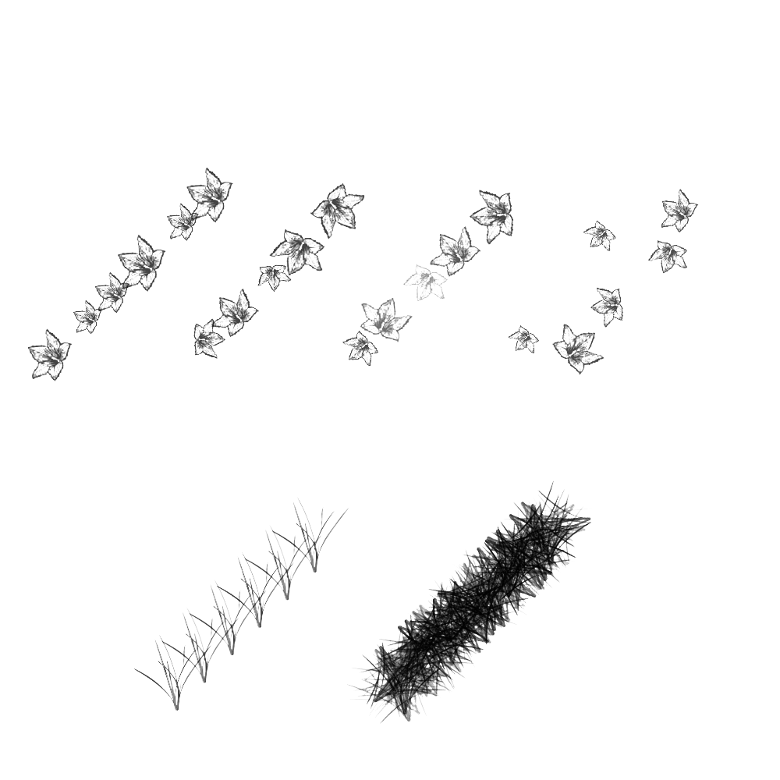
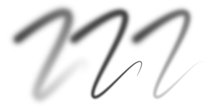
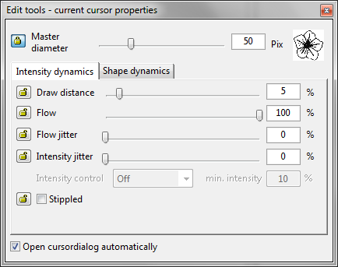
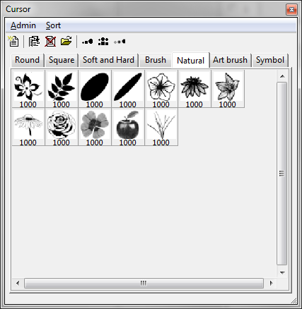
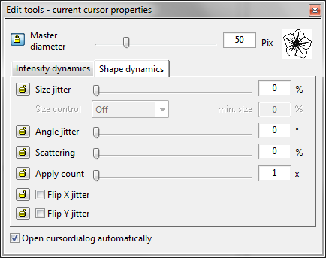
smooth drawing tools, cursor dynamics and cursor shapes
size jitter
+angle jitter
+intensity jitter
+scattering
grass cursor
normal drawn
grass cursor using
Angle jitter = 360°
Multi apply count = 4
and a low draw distance
Highest quality drawing tools supporting a flow factor for very fluent and smooth drawing even with fading and tapering.
Additionally a lot of “cursor dynamics” and predefined cursor shapes allow you to draw artful designs.

Slide 8




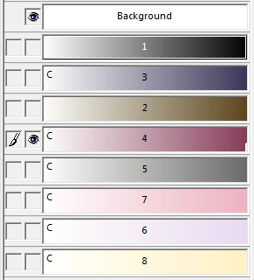
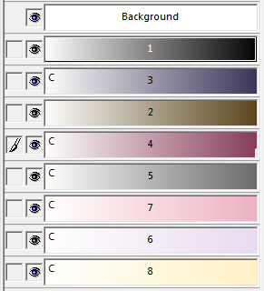



improvements in Edit tools
Tapering + fading for freehand brush and polygon
Page
Down
Page
Up
Transfer tone from black to blue separation and even add it a 2nd time…
Drawing tool "Polygon" now supports fading and tapering.
Freehand drawing tool “brush” now supports fading and tapering (after button release)
Drawing mode “Transfer tone” now can add (instead of replace) tonal information.
Page-Up/Down to quickly hide/show not selected (none drawing) separations.

Slide 9
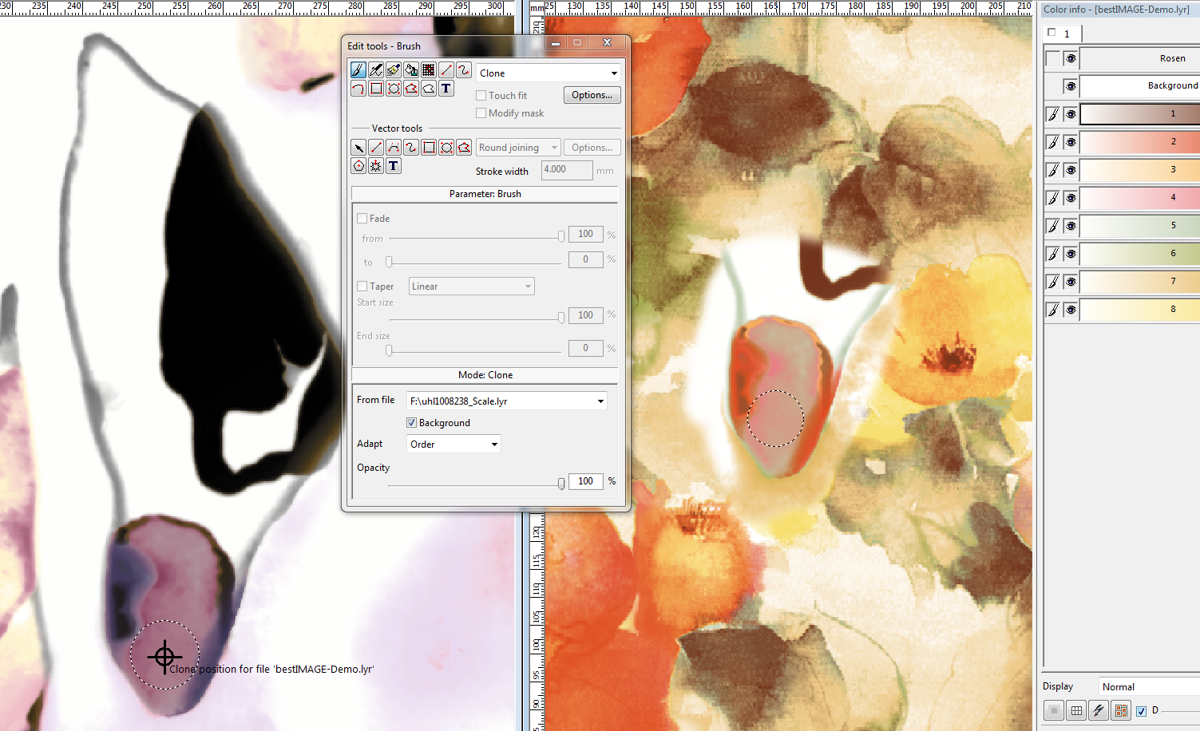
Clone from other File
It is possible now to clone separations from any other *.lyr file to the current editing file.
You can clone 1 specific separation or several separations using name or print sequence association.
Clone now also supports just to clone tonal information which is not background.

Slide 10
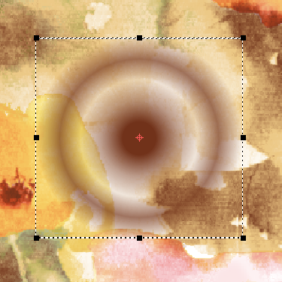
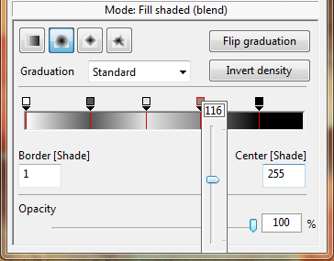
"Fill Shade" now has options to define complex graduations
Fill Shade and Fill Shade (blend) can define complex graduations with several intermediate graduation values.
This is available for vector tools as well as for drawing tools.

Slide 11
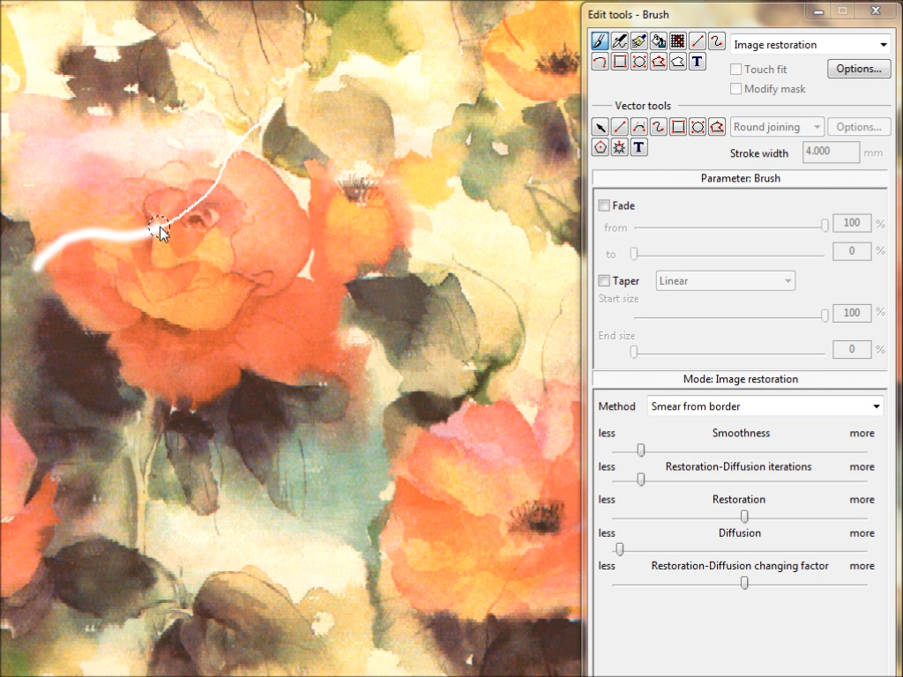
Image Restoration
2 modes of Image repairing are now supported:
Smear from boarder, which repairs like sewing image parts together.
Copy similar parts (from around or other region), which repairs like a patching tool (looks for matching patterns from another “good” region)

Slide 12
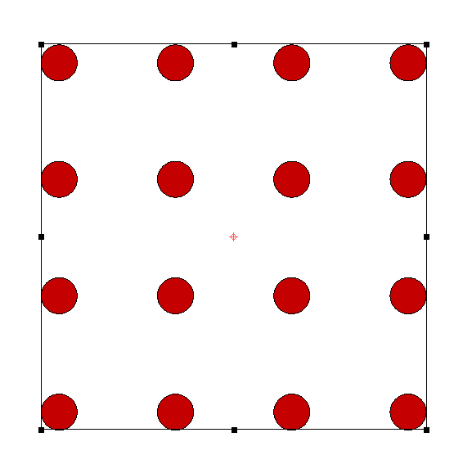
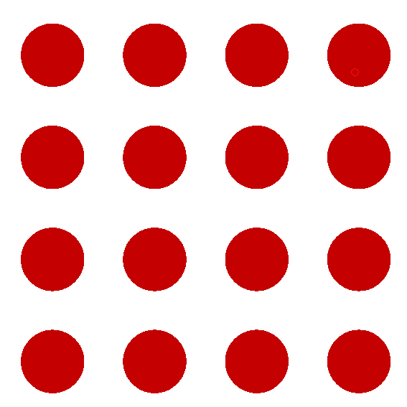
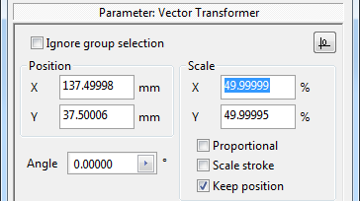
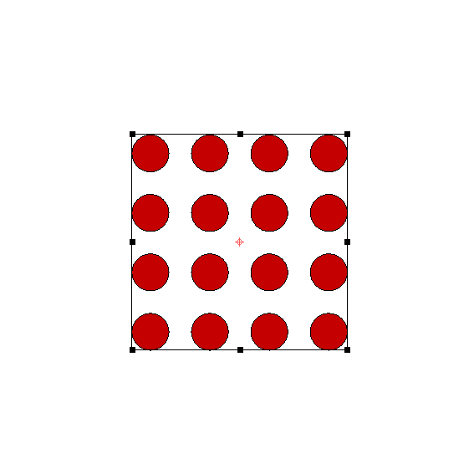
Vector objects improvements
Scaling 50% with keep position
Scaling 50% without keep position
New option to change size of several vector objects but keep individual positions. (see below)
New option "Fit to repeat" for vector object repeater.
Vector objects now can be named.
Combine vector object group to path object.
Split path object to sub path objects.

Slide 13
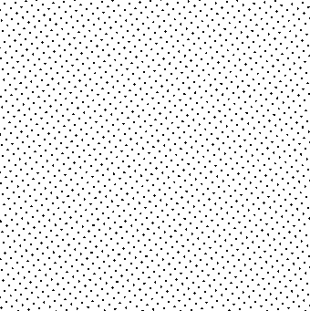

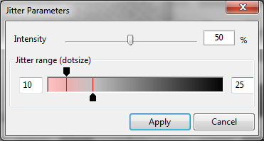
Raster-Dot Jitter
Production/Engraving
Rast dot position jitter can now be added to avoid Moire effects.
This jitter can be defined by intensity and can be applied smooth form highlights to mid-tones.

Slide 14
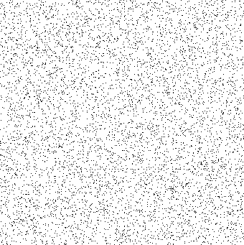

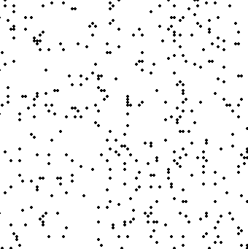
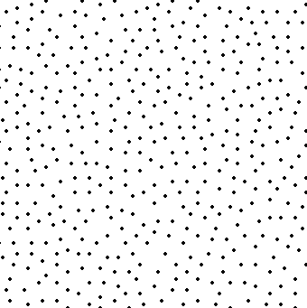
New FM Raster "Clear dots"
The new “Clear dots” Raster does not place dots completely by random, but has the intelligence to spread points homogeneous.
This leads to smoother prints than traditional Random raster.
It is also possible to generate square or round FM raster dots composed of several pixels.

Slide 15
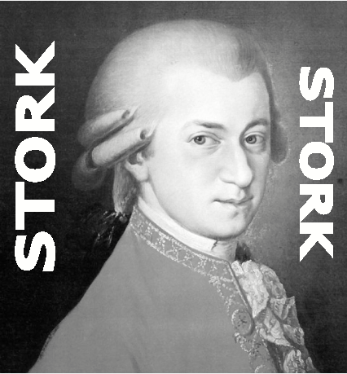
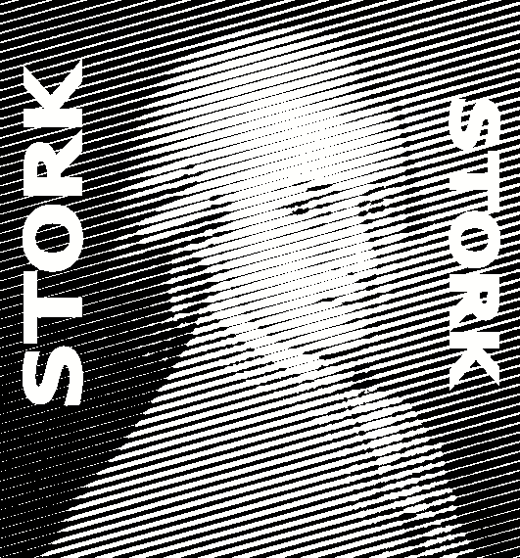
New "Line" Raster
The Existing Raster function is extended with the “Line” mode.
L/cm defines the distance and the angle defines the direction of the lines.

Slide 16
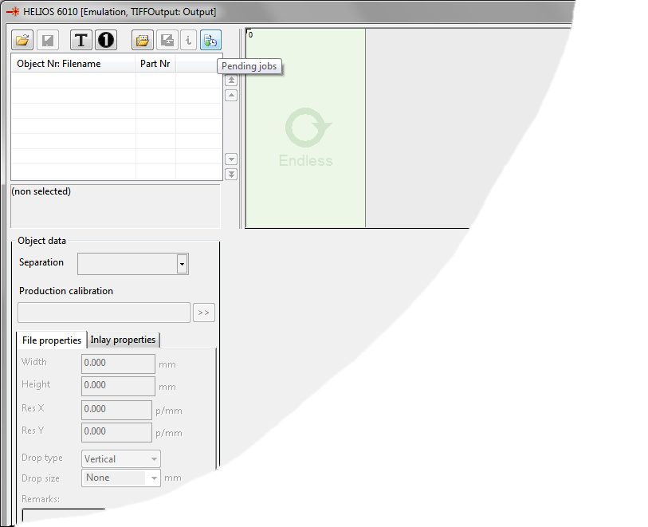
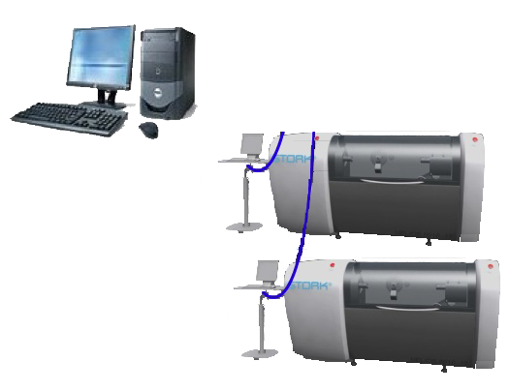
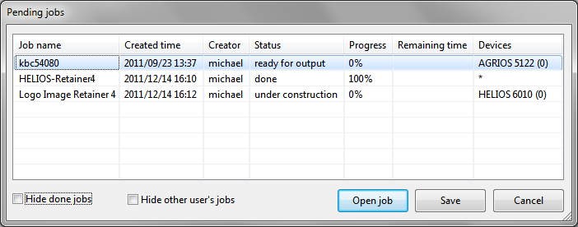
Job automation
Network
With new job editor you can setup jobs on your CAD system and spool them direct to the device, where operator gets informed about the new job.
You can monitor on the CAD station (or Flexo power station) about the progress of your jobs of all machines.
To setup job automation you just have to define a shared root directory of all your jobs in Extras/Settings/Directories.

Slide 17
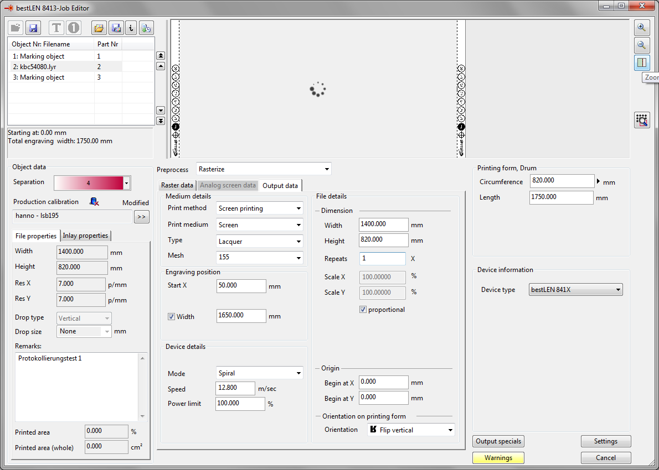
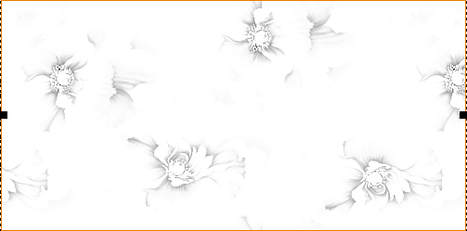
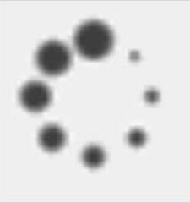
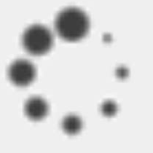
Minor improvements
Job parameter can be changed fluent as user has not to wait for
preview updates
Preview updates do no longer stall user from fluent working.

Slide 18
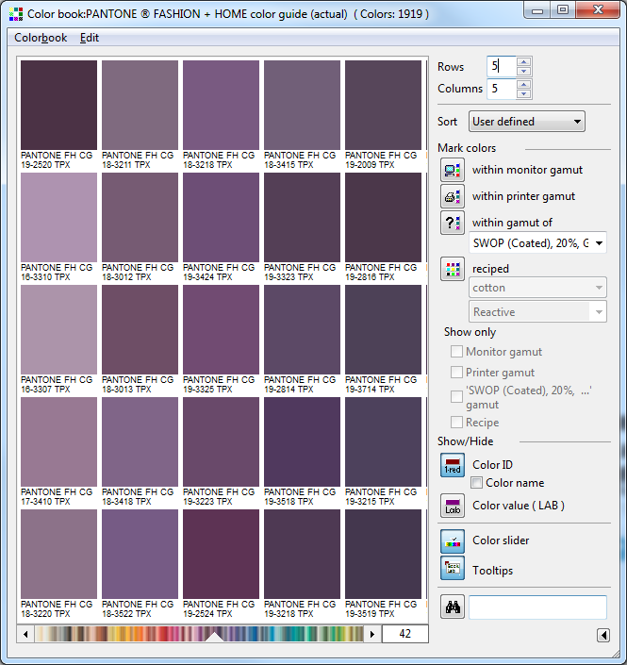
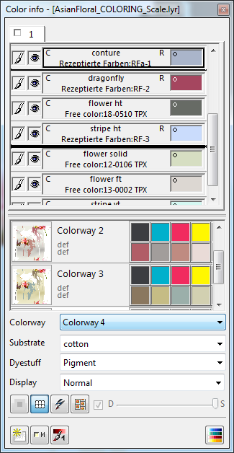
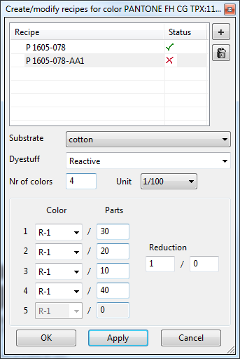
Color recipes support in color books to manage multiple recipes per color for dyestuff groups and substrates
Colouring /SimulatioN
Assign colour book colour to separations of the current file
Define recipe(s) for each colour
Recipe Manager: Substrates, Dyestuffs and Base colors are created and handled. Additional the Overlay display factors in % can be defined and assigned to each chosen substrate + dyestuff group
Recipe color: Recipes of a specified substrate and dyestuff can be created for each colour in the colour book.
Colour info: Colours with recipes can be assigned to separations of the current file.

Slide 19
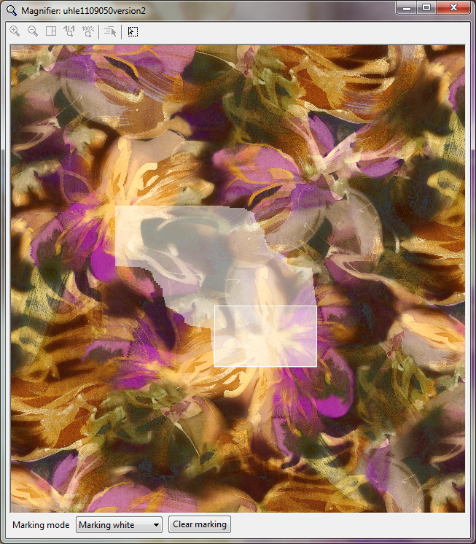
Magnifier window to pan through file with inspection marking option
General
Clears all marked sections
Choose marking colour:
black or white
Marking mode: Marking mode can be used to prevent repeatedly editing of already modified areas. The shown section of the “drawing area” is marked with the chosen color (black or white). All movements of the drawing area is logged and marked in the Magnifier.

Slide 20
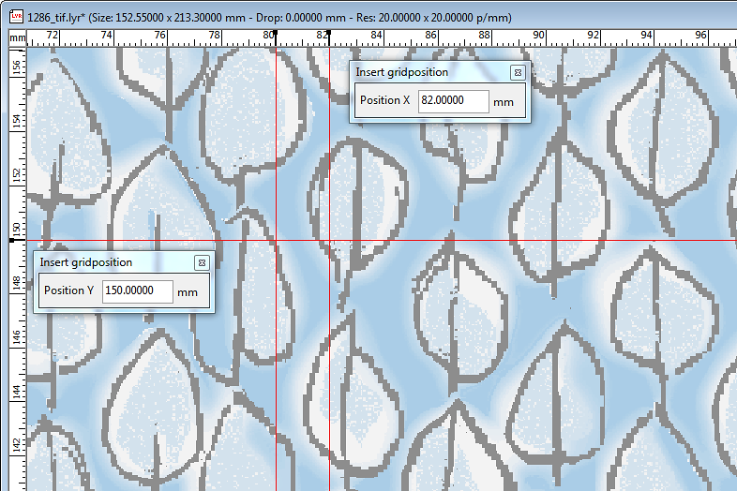
Manual input of Gridlines
Define X position of the gridline
Open the “Insert gridline” dialog within the horizontal ruler
Define Y position of the gridline
Open the “Insert gridline” dialog within the vertical ruler
Insert grid line: Grid lines can be placed on specified on positions. With context menu "Insert grid line“ within the ruler a dialog opens where positions can be defined. Enter places the gridline.

Slide 21
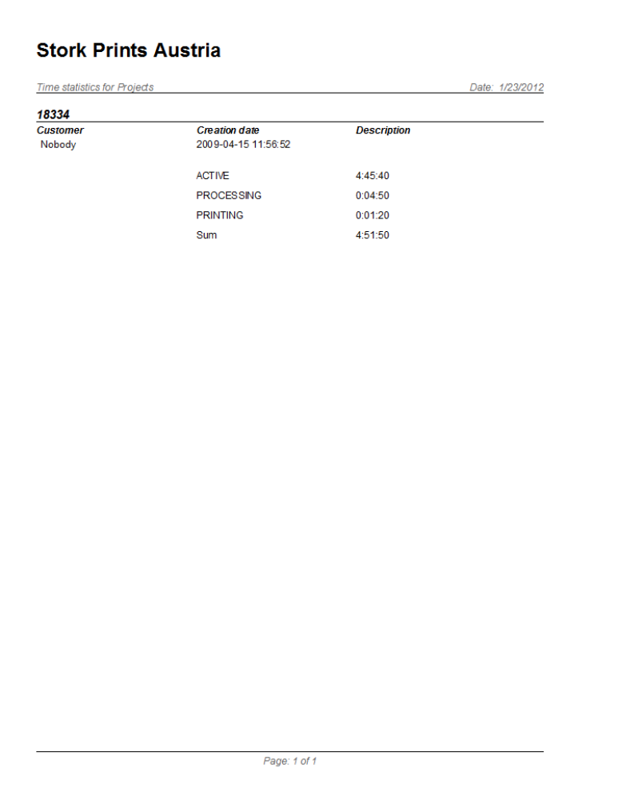
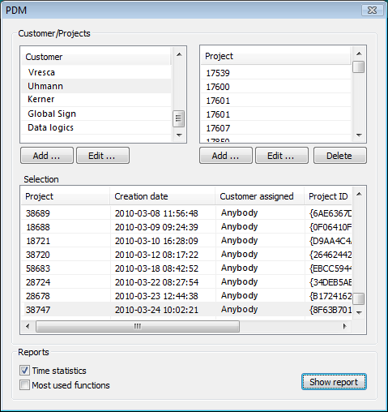
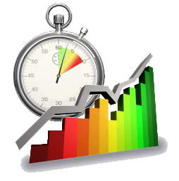
New User interface for PDM reports
The new user interface is much more compact and has all functionality in 1 simple dialog:
Customer management
Project management
Show/print projects time statistics (active, processing, printing times)

Slide 22

Copyright © 2012 by Stork Prints Austria GmbH. Permission to copy without fee all or part of this material is granted provided that the copies are not made or distributed for direct commercial advantage and the Stork Prints Austria copyright notice appears. If the majority of the document is copied or redistributed, it must be distributed verbatim, without repagination or reformatting. To copy otherwise requires specific permission from Stork Prints Austria GmbH.
Stork Prints may make changes to specifications and product descriptions at any time, without notice.

